Slide 1
Universal Acceptance
Don Hollander| UA Initiative Manager| 14 May 2015

Slide 2
What is Universal Acceptance?
Notes:
Breakup your presentation, divide it into sections. This is especially useful if most of your presentation is text.

Slide 3
Universal Acceptance (UA)
Universal Acceptance- All TLDs are as acceptable as .com / .net in applications and websites and email. Meaning any person can register and use any top-level domain (TLD) name in any format: web browsers, mobile apps, emails and setting up online accounts for Internet and other services.
Notes:
This is a simpler agenda slide, the outline for your presentation.

Slide 4
What is it?
Notes:
Breakup your presentation, divide it into sections. This is especially useful if most of your presentation is text.

Slide 5
Validation on entry
Not all domain names in a TLD are useable in applications
  ‘New’ TLDs are different
    Non-ASCII
    More than three characters
    Rapid addition of TLDs
  E-mail addresses rejected
  Browser interpret entry as a search string, not an address
Notes:
This is a simpler agenda slide, the outline for your presentation.

Slide 6
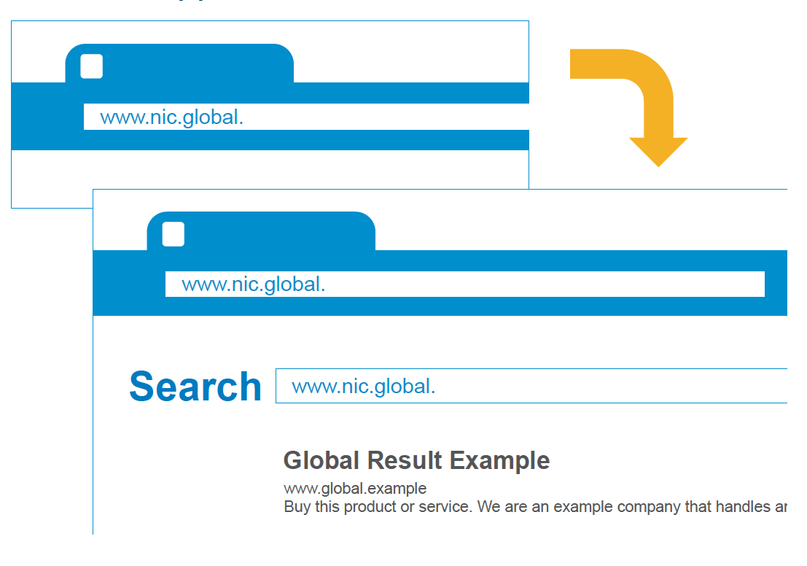
Lack of Support: All TLDs
Notes:
This is a simpler agenda slide, the outline for your presentation.

Slide 7
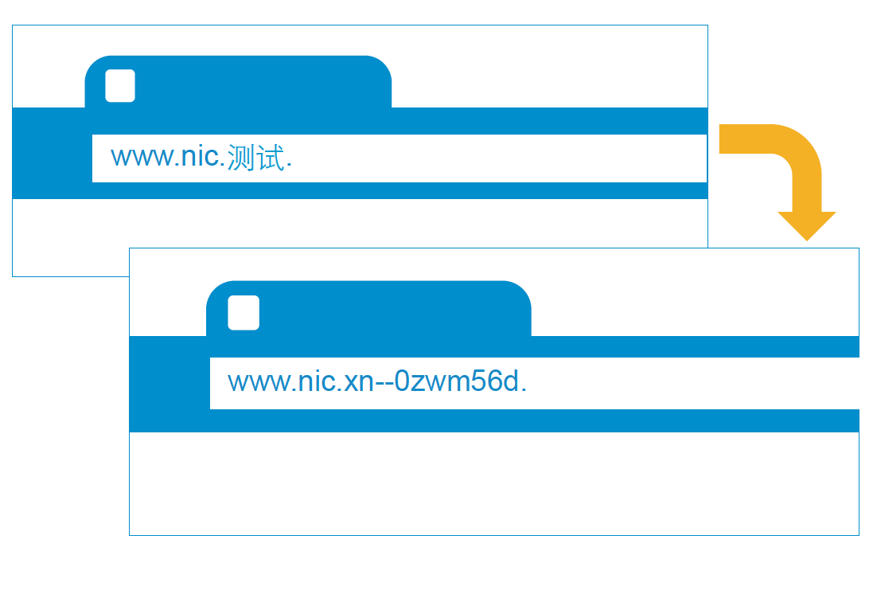
Lack of Support: Internationalized Domain Names
Notes:
This is a simpler agenda slide, the outline for your presentation.

Slide 8
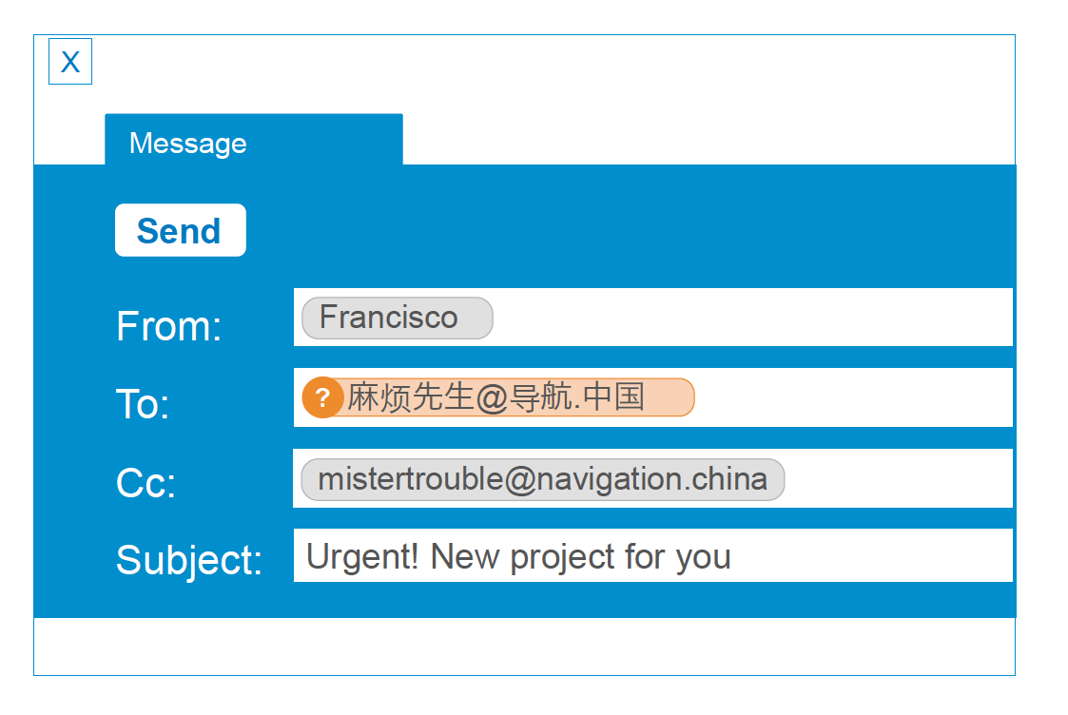
Lack of Support: Internationalized Email
Notes:
This is a simpler agenda slide, the outline for your presentation.

Slide 9
Storage
Domain Addresses could be stored as 8-bit UTF-8 characters instead of the standard 7-bit ASCII.
Domains Addresses could be stored as Puny Code (xn--…) instead of Unicode.
URL vs IRLs – what’s to the Right of the “/” – and how is that stored?
Transformation will need to be done on the way in and on the way out.
Notes:
This is a simpler agenda slide, the outline for your presentation.

Slide 10
Processing
There are probably some network devices that have firewalls hardcoded for TLD validation.
Browsers need to learn when an address is an address and when it is a search term
Other devices need to know that there are new TLDs being added every day that are no longer all in ASCII. [Think about your clever photocopier that will e-mail your scanned document. Can it cope with an non-ASCII address?]
Notes:
This is a simpler agenda slide, the outline for your presentation.

Slide 11
Display
Software needs to determine what it will display and under what circumstances.
Unicode or Punycode?
What if the device can’t display the characters?
What if a Unicode script is not installed?
Notes:
This is a simpler agenda slide, the outline for your presentation.

Slide 12
Emails
How are addresses treated?
Are all Mail Servers compliant? Clients?
What happens when mail encounters a non-compliant server or client?
What happens when a list of addresses included EAIs and ASCII addresses?
What happens when scripts are mixed? Particularly Arabic or Hebrew (Right to Left scripts)
Notes:
This is a simpler agenda slide, the outline for your presentation.

Slide 13
Who’s doing something about it?
Notes:
Breakup your presentation, divide it into sections. This is especially useful if most of your presentation is text.

Slide 14
UA Contributors
Most major Internet browsers and e-mail operations
Vendors
IANA
Universal Acceptance Steering Group (UASG)
Notes:
This is a simpler agenda slide, the outline for your presentation.

Slide 15
Universal Acceptance Steering Group
UASG Leaders & Coordinators
UASG Subgroups
  Topline & Technical Issues
  Internationalization
  Measurement and Monitoring
  Community Outreach
  Coordination Group
Notes:
This is a simpler agenda slide, the outline for your presentation.

Slide 16
Topline & Technical Issues
Identifying most effective areas to focus
Developing definitions
Developing technical specifications for solutions
Developing use cases
Defining UA ready
Notes:
This is a simpler agenda slide, the outline for your presentation.

Slide 17
Internationalization
Internationalized Domain Names focused
Email Address Internationalization Focused
Request for Comments
Notes:
This is a simpler agenda slide, the outline for your presentation.

Slide 18
Measurement & Monitoring
Defining success
Building test platforms
Monitoring based on definitions
Building knowledge base
Collating complaints
Notes:
This is a simpler agenda slide, the outline for your presentation.

Slide 19
Community Outreach
Slicing and dicing communities of interest
  Geographic
  Application
  Industry
Creating white papers
Ambassadorships
Notes:
This is a simpler agenda slide, the outline for your presentation.

Slide 20
How can you help?
Notes:
Breakup your presentation, divide it into sections. This is especially useful if most of your presentation is text.

Slide 21
How Can You Help?
Get involved
Spread the word
Test your own systems
Advocate to your suppliers, governments, community leaders
Notes:
This is a simpler agenda slide, the outline for your presentation.

Slide 22
Engage with UASG
Thank You and Questions
Reach us at:
Email: xxxx@xxx.com
Website: icann.org
General Universal Mailing List
https://mm.icann.org/mailman/listinfo/ua-discuss
Topline & Technical Issues Project Group
https://mm.icann.org/mailman/listinfo/ua-priority-issues
Community Outreach Project Group
https://mm.icann.org/mailman/listinfo/ua-comms
Internationalization Project Group
https://mm.icann.org/mailman/listinfo/ua-international
Measurement & Monitoring Project Group
https://mm.icann.org/mailman/listinfo/ua-Measurement
Notes:
You can adjust the email/web address to whichever email or web address is best suited to your presentation. This should be your final slide.

