Slide 1
At-Large Technology TaskForce
ICANN 52 - Singapore | 12 February 2015

Slide 2

At-Large Technology TaskForce Agenda
1
2
Introduction to the At-Large Technology TaskForce (TTF)
Report on the Implementation of At-Large Summit II recommendations
3
4
Review of webconferencing tools for use by ICANN & At-Large
Community Feedback - what should the TTF
be looking at?
Notes:
This is a stylized agenda slide for your presentation.
To delete a box, if there are too many boxes, click the edge of the box, ensure the entire box is highlighted, then DELETE.
To update the numbers and text, click inside the circle for the numbers or in the box for the text, revise the text.

Slide 3
Section 1
Introduction to the
At-Large Technology Taskforce (TTF)
Notes:
Breakup your presentation, divide it into sections. This is especially useful if most of your presentation is text.

Slide 4
About the At-Large Technology Taskforce
The establishment of the At-Large Technology Taskforce (TTF) came out of the recommendations from the ALAC/At-Large Improvements Project Final Report (https://community.icann.org/x/fAIQAg) in June 2012. In particular:
  Introduce to At-Large Structures (ALS) selected information, dissemination, communication and collaboration tools and provide training.
  Review of communication and collaboration needs considered unmet by ALSes and Regional At-Large Organisations (RALOs) globally by evaluating technologies currently in use by At-Large or elsewhere in ICANN and to identify and review other technologies as they become available.

Slide 5
TTF Members
AFRALO - Beran Dondeh Gillen, Seun Ojedeji, Sarah Kiden, Wilson Abigaba,
Titilayo Bolarinwa
APRALO - Gunela Astbrink, Ali AlMeshal, Sivasubramanian M, Nirmal Agarwal, Fouad Bajwa, Emani Fakaotimanava-Lui, Chaitanya Dhareshwar
EURALO - Olivier Crepin-Leblond
LACRALO - Dev Anand Teelucksingh (chair), Juan Manuel Rojas, Lance Hinds,
Jose Arce, Carlos Watson
NARALO - Glenn McKnight (co-chair), Judith Hellerstein (co-chair),
Gordon Chillcott, Bill Thanis, Murray McKercher, Avri Doria
Notes:
Insert a 364 x 395 pixels photo.

Slide 6
About the At-Large Technology TaskForce
Who can be in the TTF?
1
The Technology Task Force (TTF) consists of members from the At-Large community.
We welcome anyone from the At-Large community to join us
How often we meet
2
We hold conference calls at least once a month,
sometimes two meetings are held in a month.
TTF Workspace where we document our activities
3
https://community.icann.org/x/JZvbAQ
TTF wiki page
4
https://community.icann.org/x/FpfbAQ
Notes:
Look for different ways to display your data or text but using alternatives to simple bullets.
To adjust the number in the arrow to text or another number, click on the text box around the number, revise.
To add an arrow, click on the arrow, ensure the arrow is highlighted, COPY and PASTE and move to the desired placement, or DELETE if there are too many arrows.

Slide 7
Section 2
Report on the Implementation of At-Large Summit II recommendations
Notes:
Breakup your presentation, divide it into sections. This is especially useful if most of your presentation is text.

Slide 8
At-Large Summit II Recommendations
The At-Large Summit II (ATLAS II) was a meeting of representatives of At-Large Structures from all RALOs at the ICANN 50th meeting in London in 2014. At ATLAS II, At-Large Representatives developed a range of recommendations and observations on the future direction of ICANN.
The complete ATLAS II declaration with all of the 43 recommendations can be found at https://community.icann.org/x/d5ThAg
Notes:
This is a simpler agenda slide, the outline for your presentation.

Slide 9
ATLAS II Summit Recommendations
Some of the 43 ATLAS II recommendations (10,11,17, 26,29,31,39)
were allocated to the TTF (some in coordination with other At-Large WGs) for implementation.
The list of ATLAS II Recommendations allocated to the TTF:
https://community.icann.org/x/YhfxAg
Notes:
This is a simpler agenda slide, the outline for your presentation.

Slide 10
ATLAS II Recommendation 10
Recommendation 10
Summary of Implementation of Rec 10
“The next evolution of language services must adopt further extension of live scribing for all meetings and generally extend the current interpretation and translation processes and make translation available in a timely manner.”
Evaluated two Adobe Connect
plugins for live captioning,
one from Adobe Connect and
one from Captions First
on the Joint Accessibility WG/Technology Taskforce meeting 2014-09-08.
https://community.icann.org/x/HwnxAg

Slide 11
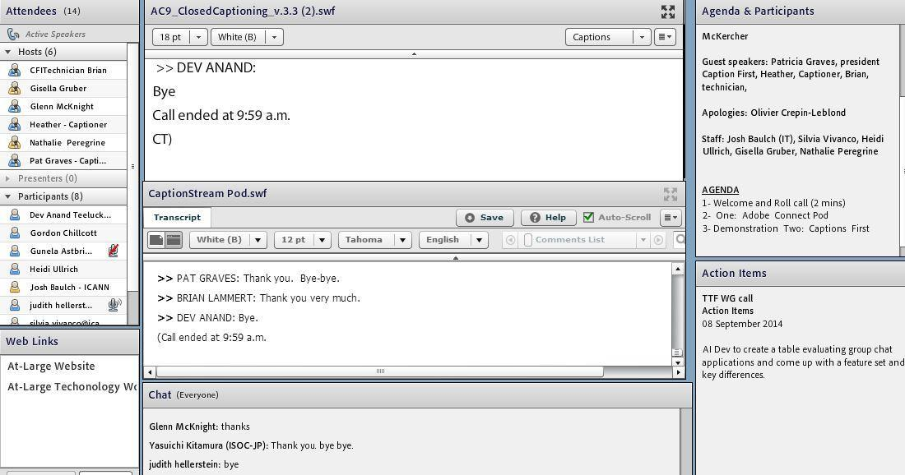

ATLAS II Recommendation 10 - Live Scribing

Slide 12
ATLAS II Recommendation 10
Summary of Implementation of Rec 10
Recommendation 10
ICANN Language Services provides interpretation
  for At-Large F2F meetings in English, Spanish and French
  English, Spanish, French and Russian for ALAC monthly conference calls.
  English, Spanish and Portuguese for LACRALO monthly calls
  English, French for AFRALO calls
For At-Large WGs, interpretation is provided on request from more than 3 persons attending a call
ICANN Language Services transcribes audio recordings of ALAC/At-Large meetings and provides a transcript in less than a week.
“The next evolution of language services must adopt further extension of live scribing for all meetings and generally extend the current interpretation and translation processes and make translation available in a timely manner.”

Slide 13
ATLAS II Recommendation 11
Recommendation 11
Summary of Implementation of
Rec 11
(As per Rec 10) ICANN Language Services provides interpretation for for ALAC/At-Large F2F meetings and ALAC and for some RALO conference calls.
However, they do not as of yet provide support for people with disabilities and special needs during working groups or conference calls.
Evaluated Caption First which offers an Adobe Connect plugin for live scribing on two calls (as per Rec 10)
A special budget request to conduct a pilot program to live caption 6 meetings/calls a month has been submitted to the FBSC
“ICANN must implement a range of services to facilitate access according to various criteria (gender; cultural diversity) and user needs (disabilities, etc…).”
Assigned to
Accessibility WG
Technology Task Force

Slide 14
ATLAS II Recommendation 11
Summary of Implementation of
Rec 11
Recommendation 11
The TTF also evaluated “Craptions to Captions”, an open source tool for captioning videos.
Also, the TTF looked at Amara, ww.amara.org , a subtitle editor that makes it easy to caption and translate videos. Amara also hosts volunteer localization & accessibility communities.
“ICANN must implement a range of services to facilitate access according to various criteria (gender; cultural diversity) and user needs (disabilities, etc…).”
Assigned to
Accessibility WG
Technology Task Force

Slide 15
ATLAS II Recommendation 11
Summary of Implementation of
Rec 11
Recommendation 11
The TTF notes the progress of machine translation tools such as Skype Preview and the already available Google Translate mobile app.
The TTF is working with ICANN IT staff to have a new version of the machine translation tools used for the LACRALO English and Spanish mailing lists. See https://community.icann.org/x/z4VZAg
“ICANN must implement a range of services to facilitate access according to various criteria (gender; cultural diversity) and user needs (disabilities, etc…).”
Assigned to
Accessibility WG
Technology Task Force

Slide 16
ATLAS II Recommendation 17
Recommendation 17
Summary of Implementation of Rec 17
“ICANN needs to be sensitive to the fact that social media are blocked in certain countries and, in conjunction with technical bodies, promote credible alternatives
At-Large Workshop on “TOR and alternative naming mechanisms to the DNS” held at ICANN Singapore 2014
https://community.icann.org/x/7CPRAg
TTF has looked at Group Chat services (https://community.icann.org/x/Hr3hAg) such as Slack, HipChat and Hall.
At-Large Social Media WG is researching alternative social media platforms where traditional ones are blocked.
Allocated to
TTF
At-Large Social Media WG

Slide 17
ATLAS II Recommendation 26
Recommendation 26
Current policy management processes within ICANN are insufficient. ICANN must implement a workable Policy Management Process System, available for use across the SO/ACs, in order to:
Enhance Knowledge Management,
improve the effectiveness of all ICANN volunteer communities,
improve cross-community policy-specific activity,
enhance policy development metrics,
facilitate multilingual engagement,
create a taxonomy of policy categories,
provide policy development history as an aid for newcomers.
Allocated to
TTF
Social Media WG
Capacity Building WG

Slide 18
ATLAS II Rec 26 - What do we want in a Policy Management Process System?
To quickly find historical information on a policy issue
1
For example, find policy history on “new gTLDs” and get a report in chronological order.
Such searches could be further refined (e.g show history in past 4 years) or show the submissions made by a particular AC/SO on a policy issue. Such searches could be visualized using a timeline (e.g http://codyhouse.co/gem/vertical-timeline/)
A system would have the policy history stored in a manner to allow for such queries.
To subscribe to policy updates/notifications by interest
2
For a person who has a keen interest in certain policy issues (e.g IDNs), persons should be able to subscribe to receive updates on specific policy issues with links to where the discussions are happening for that AC/SO.
This is where a taxonomy of policy categories to be defined for past, current and future/upcoming policies. Furthermore, a policy system could track past user interactions, so that if a person commented on a particular policy issue (e.g WHOIS), they could be notified of new, related policy issues for their review.
Track deadlines for responding to policy comments
3
With multiple policy comment periods happening simultaneously at different stages, a system should update a calendar or other system for the AC/SO to track and manage deadlines.

Slide 19
ATLAS II Rec 26 - What do we want in a Policy Management Process System?
4
The ability to read policy issues and updates in your language
Comment Periods on Policies posted for review are posted in English with translated policy documents being uploaded at a later time. Persons should be able to subscribe to notifications when policies are available in their language to review.
Having the policy review process more accessible to mobile users
5
With more and more users using mobile devices, the policy review process should be made accessible to such users to engage in the policy process.
Reduce the manual duplication to disseminate information
6
AC/SOs expend a lot of effort to manually copying and pasting text in order to disseminate policy information to the communities and to the wider public (wiki pages, emails, sharing on social media). A system should offer sharing mechanisms so that persons wanting to get the word out can do so more easily.
7
What do you want in a Policy Management Process System?

Slide 20
ATLAS II Recommendation 26
Recommendation 26
Summary of Implementation of Rec 26
Current policy management processes within ICANN are insufficient.
ICANN must implement a workable Policy Management Process System, available for use across the SO/ACs, in order to:
Enhance Knowledge Management,
improve the effectiveness of all ICANN volunteer communities,
improve cross-community policy-specific activity,
enhance policy development metrics,
facilitate multilingual engagement,
create a taxonomy of policy categories,
provide policy development history as an aid for newcomers.
The At-Large Website Redesign is underway - part of the website design attempts to provide a policy background on policy issues as well as to create a taxonomy of policy categories and highlight policy metrics.
A mockup of the Website can be viewed at https://new-atlarge.herokuapp.com/
The TTF will be reviewing the Policy Development Processes at the Regional Internet Registries (RIRs) to see what could be adapted for At-Large Policy Development

Slide 21
ATLAS II Recommendation 29
Recommendation 29
Summary of Implementation of Rec 29
The ALAC should implement an automated system for tracking topics of interest currently being discussed among the various RALOs, and accessible by everyone.
The TTF looking to syndicate RALO topics across all RALO wiki pages using the Confluence’s wiki capabilities.
Wiki addons such as Confluence Questions (http://bit.ly/1EUah6O) & group chat applications may allow for such crowdsourcing of topic discussions ;
TTF to continue evaluation
Allocated to
Capacity Building WG
Technology Task Force
At-Large Social Media WG

Slide 22

ATLAS II Recommendation 31
Recommendation 31
Summary of Implementation of Rec 31
ICANN and the ALAC should investigate the use of simple tools and methods to facilitate participation in public comments, and the use of crowdsourcing.
The TTF is to review tools such as Liquid Feedback ( http://liquidfeedback.org/ )
Allocated to
TTF
At-Large Social Media WG
RALO chairs

Slide 23
ATLAS II Recommendation 39
Recommendation 39
Summary of Implementation of Rec 39
ICANN should encourage “open data” best practices that foster re-use of the information by any third party.
A significant amount of information produced by ICANN and At-Large over the years is already public however, its not stored in an organised way, (wikis, websites) making information hard to locate and to re-use.
The TTF is reviewing how best to implement open data standards. Some of the resources on Open Data include:
The Open Data Handbook http://opendatahandbook.org/
Open Data Guide (http://opendata.guide/)
Open Data Foundation (http://opendatafoundation.org/)

Slide 24
Section 3
Review of
webconferencing tools for use
by ICANN & At-Large
Notes:
Breakup your presentation, divide it into sections. This is especially useful if most of your presentation is text.

Slide 25
Web Conferencing Tools
The TTF reviewed over a dozen web conferencing tools other than Adobe Connect.
Special purpose calls were done with TTF members testing each of the solutions looking at usability, features, accessibility, cost and cross platform availability (OS and mobile)
Comparison table of the web conferencing solutions tested
(Adobe Connect, Lucid Meetings, BlueJeans, ReadyTalk, Webex.com, GoMeetNow join.me, MeetingBurner, Infinite Conferencing, AnyMeeting, Jitsi Meet)
https://community.icann.org/x/O1R-Ag
The TTF is looking to come up with web conferencing recommendations for possible use by At-Large Structures.
Notes:
his is a simpler agenda slide, the outline for your presentation.

Slide 26
Web Conferencing Tools - Adobe Connect
The TTF developed the One Pager about Adobe Connect
https://community.icann.org/x/DD9-Ag to help ALSes use Adobe Connect effectively.
The TTF has done some testing of Adobe Connect plugins
https://community.icann.org/x/nYUQAw with two more plugins to be evaluated (engagement index, social media)
Notes:
his is a simpler agenda slide, the outline for your presentation.

Slide 27
Section 4
Community Feedback - what should the Technology Taskforce be looking at?
Notes:
Breakup your presentation, divide it into sections. This is especially useful if most of your presentation is text.

Slide 28
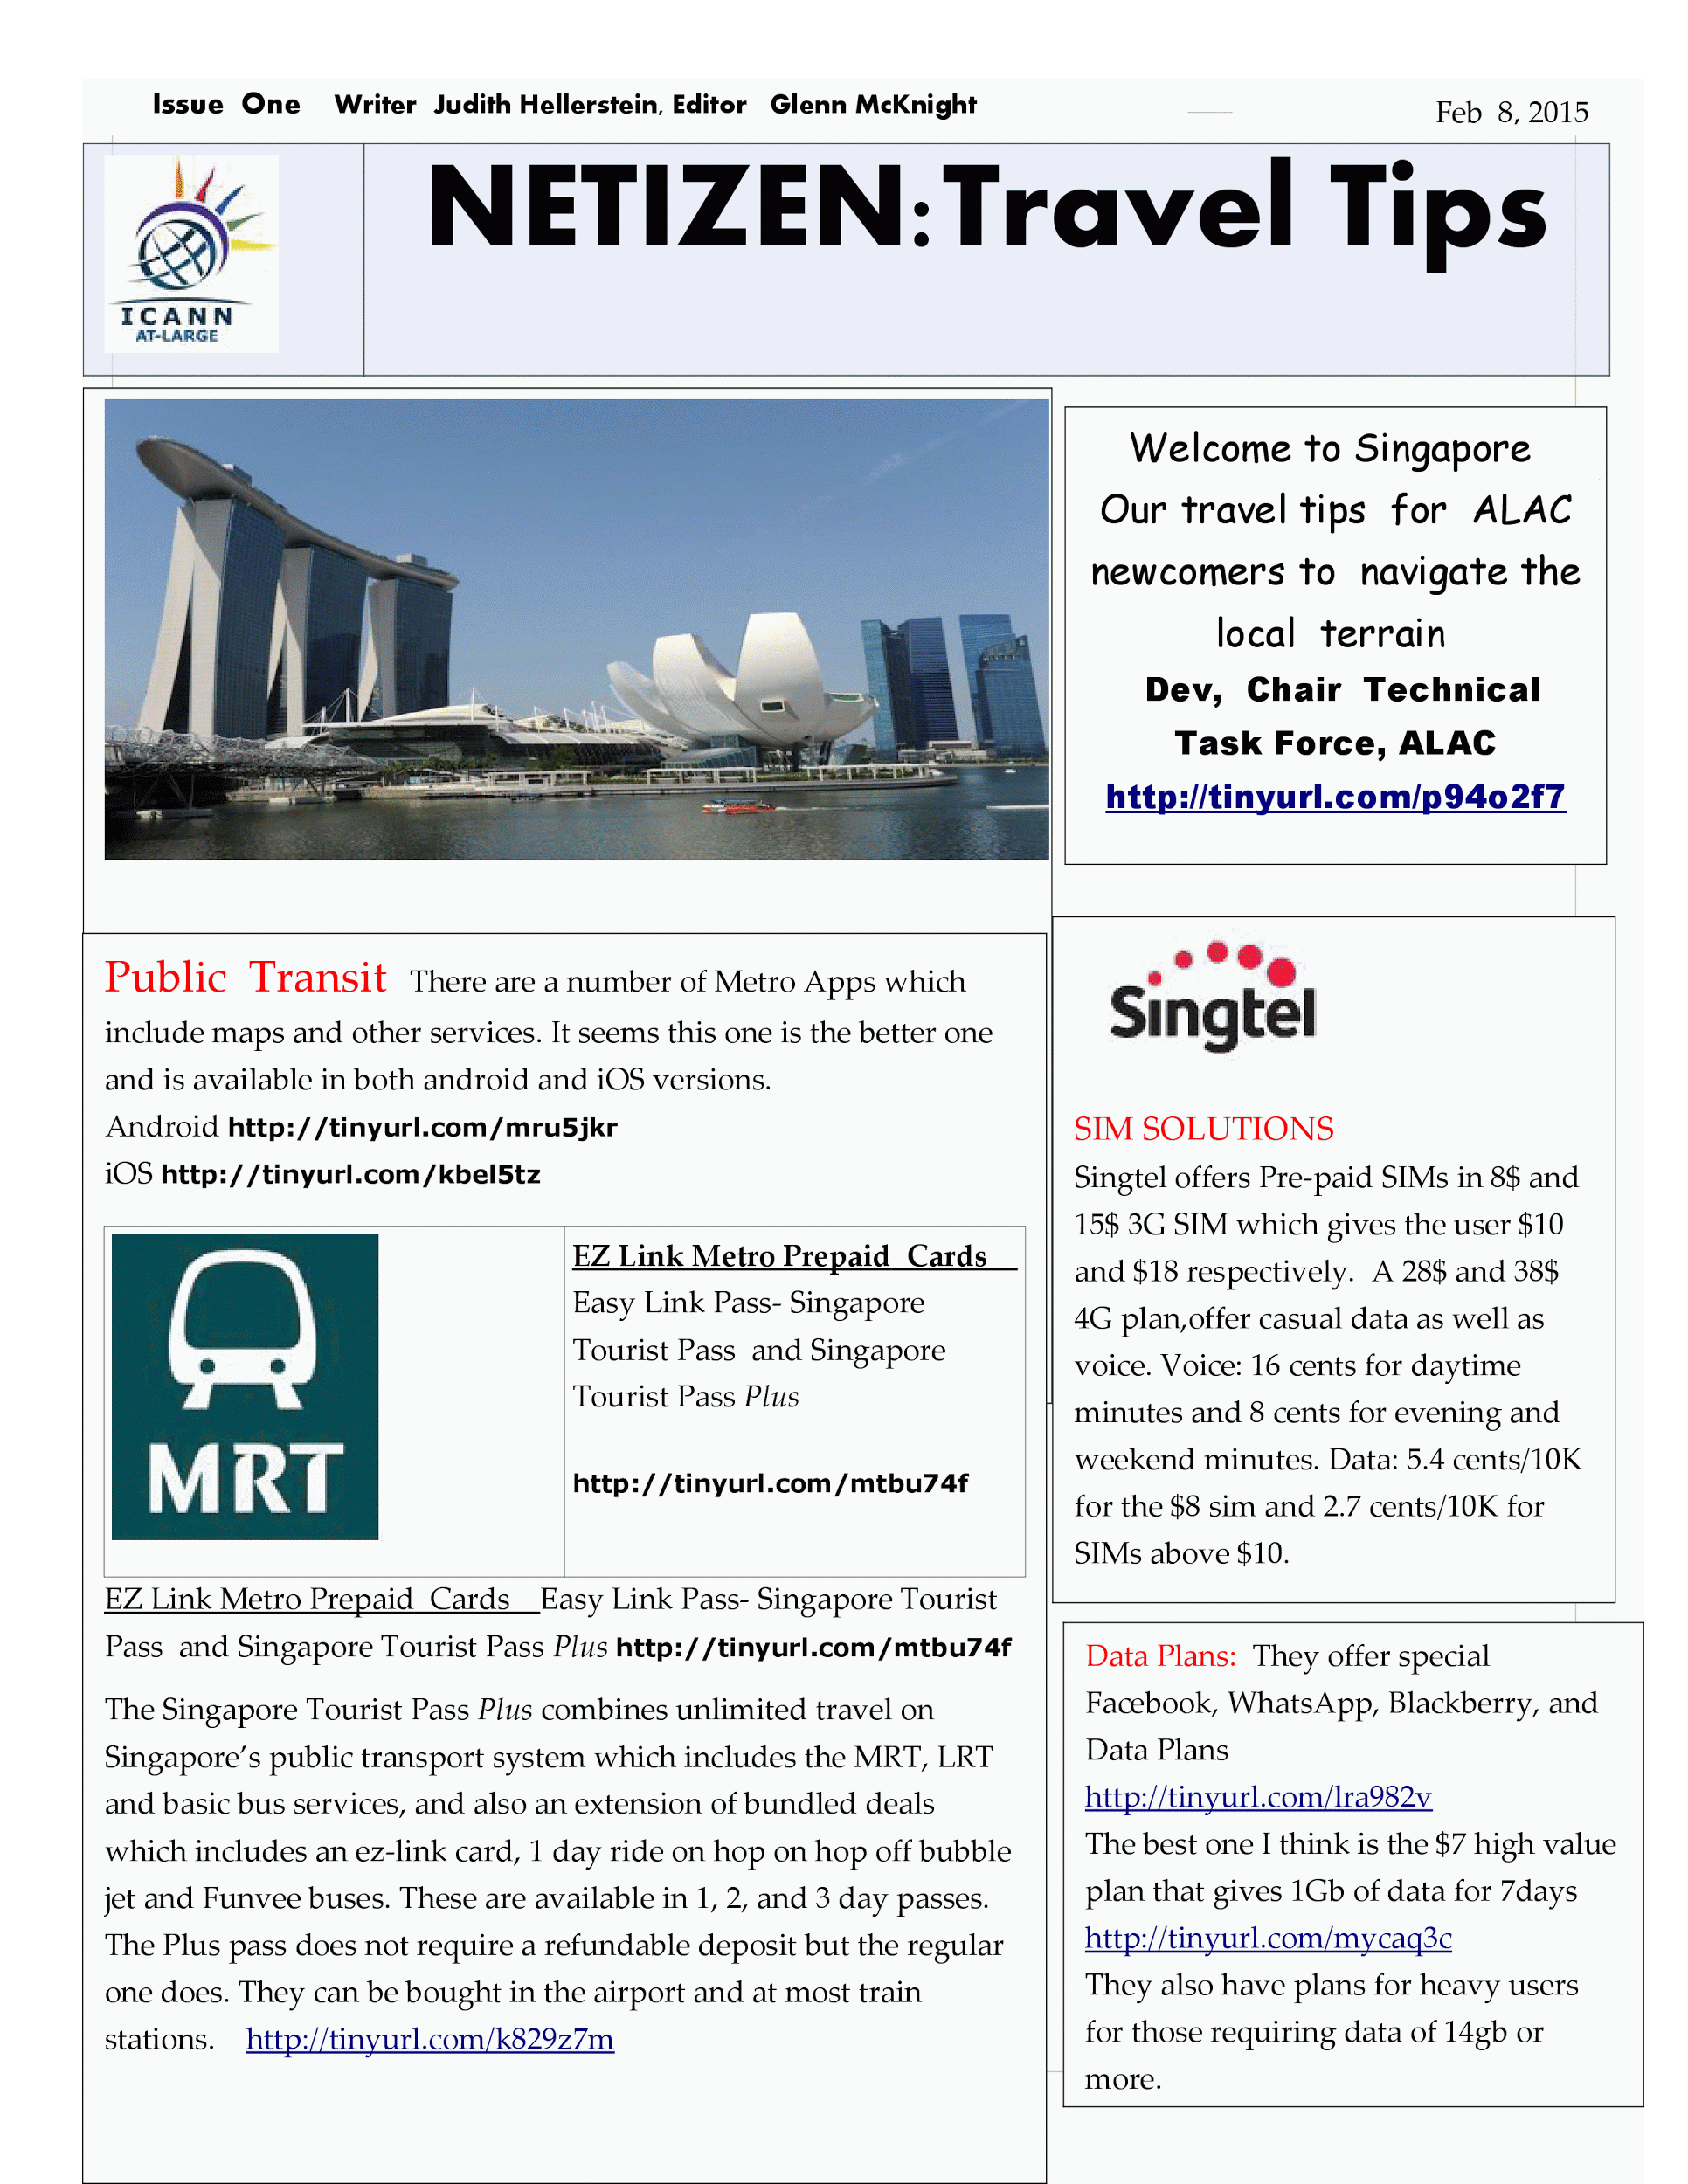
Technical Taskforce Travel Tips: Singapore Newspaper
The Technical Taskforce members are starting a new project to produce for ALAC members a tips sheet for each of the ICANN meetings.
The content is available at the
TTF WIKI page at
https://community.icann.org/x/RwEdAw
Please provide your comments and suggestions

Slide 29
What should the TTF be looking at?
Open Discussion
Notes:
Use this slide for diagrams or other graphic elements.

Slide 30




Contact the TTF
Thank You and Questions
Reach us at:
Email: ttf@atlarge-lists.icann.org
Website: https://community.icann.org/x/FpfbAQ
twitter.com/icann_atlarge
facebook.com/icann.atlarge
youtube.com/user/icannatlarge
Notes:
You can adjust the email/web address to whichever email or web address is best suited to your presentation. This should be your final slide.

